Slide 1
DECT-2020 Component of the IMT-2020 SRIT Proposal from ETSI
Doc: DECT(19)000255r2
Source: ETSI TC DECT
Dr. Guenter Kleindl, TC DECT Chairman
Juho Pirskanen, Wirepas
Angel Bóveda, Wireless Partners
ITU-R WP5D, 10 December 2019

Slide 2
Contents
DECT-2020 Key features
Technical Characteristics
mMTC Evaluation overview
mMTC Simulation results
URLLC Evaluation overview
URLLC Simulation results
Summary

Slide 3
DECT-2020 key features

Slide 4
DECT-2020 Key features
Flexible radio access technology with dynamic channel selection based on cognitive radio (spectrum sensing)
No frequency planning required
Compatible with legacy DECT technology including uncoordinated systems
Improved transmission quality, link budget and increased data rate compared to legacy DECT
Support of scheduled and unscheduled services
Support of low latency operation
Support of ultra low power consumption devices
Support of seamless handover
Support of Mesh radio network topologies
Support of MIMO
Up-to-date security based on AES and CCM

Slide 5
Technical Characteristics
Radio technology is OFDM with MIMO support
Sub-carrier spacing is 27 kHz with scaling option up to 432 kHz
Symbol time is 41.67 µs. Cyclic prefix is 4.3 µs
TDMA/FDMA based channel access
Basic frame is 10 ms, split into 24 or 48 time slots, time slots can be aggregated
Dual mode MAC architecture supporting unscheduled and scheduled services
Basic channel width is 1.728 MHz, channels can be aggregated
Modulation types: BPSK, QPSK, 16QAM, 64QAM, 256QAM, 1024QAM
Coding: Convolutional, Turbo, LDPC
Data rates 120 kbps to 1.1 Gbps with 27 kHz sub-carrier spacing up to 8.6 Gbps with 216 kHz sub-carrier spacing

Slide 6
Network integration
DECT-2020 is a pure RAN technology. No core network concept is provided
For devices supporting both 3GPP NR and DECT-2020 radio network , interconnection with a 3GPP Core Network can be done by means of standard 3GPP mechanisms (see 3GPP TS 23.501 Rel. 16) using trusted or un-trusted access

Slide 7
DECT-2020 Self Evaluation

Slide 8
DECT-2020 Self Evaluation
Scenario | Self Evaluation
Enhanced Mobile Broad Band (eMBB) | No (*) (covered by 3GPP NR)
Massive Machine Type Communications (mMTC) | Yes
Ultra-Reliable Low Latency Communications (URLLC) | Yes
* The technology implements some capabilities towards eMBB that are noted in the submission template, however no eMBB support is claimed at this stage. This scenario may be added in the future.

Slide 9
mMTC evaluation & simulation

Slide 10
mMTC Evaluation Overview
Urban Macro Cell environment as defined by ITU-R mMTC Test scenario.
The connection density is defined as 1 000 000 devices per km², with each device sending 32 byte packet in every 2 hours.
The requirement is that each TRxP sector/cell (in DECT terms: FP/sink) can receive 10 packets/s.
Packet Outage i.e. the packet drop ratio to be evaluated is: 1 %. Packet may be lost in any hop.
The maximum packet delivery delay is 10 seconds. Packet delay is the end to end delay from data source to FP/sink.
Parameter | Value
ISD | 500m
Number of TRxP | 19*3 = 57
Area per TRxP (ISD^2*sqrt(3)/6): [km²] | 0.072
Total simulation area [km²]: | 4.11
ITU-R density target per km² | 1 000 000
Number of devices in simulation | 4.11 million
Number of messages per hour per device | 0.5
Number of messages per hour | 2.06 million
Number of messages per TRxP per second | 10
Link performance is based on QPSK modulation with ¾ coding rate.
Single 32-byte packet takes full slot (0.416 ms). Transmission could carry 58 bytes (80% over dimensioning).
Acknowledgement (ACK) feedback is transmitted in a full slot. No multiplexing of ACK’s applied, which would increase capacity significantly.
No HARQ soft-combing gain considered between transmissions.
Maximum number of re-transmissions are limited per hop, impacting the Packet Outage performance.

Slide 11
mMTC Evaluation Overview
The device processing time has been taken into account:
The ACK transmission can start 2 ms after reception of the packet, i.e. 2 ms is reserved for the packet decoding delay.
After ACK transmission, the device can forward the data to the next hop in the mesh topology.
Transmissions of ACK’s are modelled in the simulation. They may collide with other data transmissions and increase the system interference (TDD system).
Each device applies the power control and reduces their TX power to the required level for the next hop communication.
Packets may also drop due to extensive number of packets stored in the device memory, the limit is set to 50 packets (1.6 KB).
However, this is an implementation related aspect, but provides us some additional indication if such issues arise.
Each device has to buffer their own data as well as the data received from other devices.
Device 1
Device 2
Device 3
FP/sink
Data (1)
Ack
Data (1)
No Ack
ReTX Data (1)
Ack
Data (1)
Ack
Example data flow from Device 1 to FP/sink

Slide 12
mMTC Evaluation Overview
Single channel results
All FP/Sinks and devices are operating at the same 1.728MHz channel.
3 channel case
Each FP/sinks and device selects own operating channel based on local interference conditions in the simulation. No manual interference planning is used.
Simulation results are available for both 700MHz and DECT1900MHz band.
All results are performed with 23dBm maximum TX power at FP/sink (BTS/TRxP) and Device.
DECT1900MHz band results are based on using 5m FP/sink (BTS/TRxP) antenna height.
700MHz results are done with 25m antenna height as requested by ITU-R.
Evaluation configuration as defined in ITU-R M.2412-0: Table 5 d) Urban Macro-mMTC test, Configuration A.

Slide 13
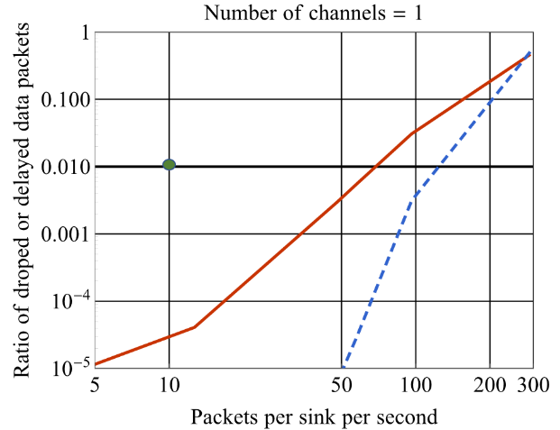
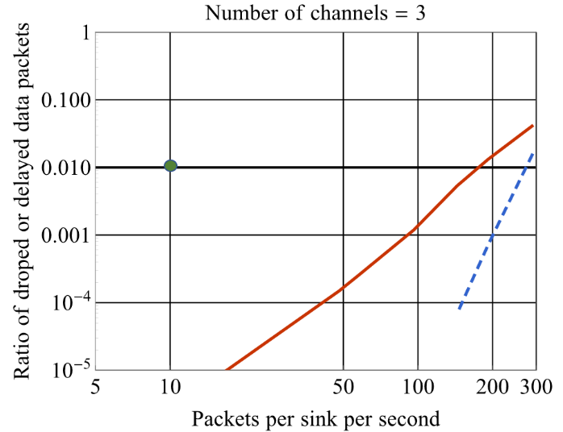
mMTC Simulation Results at 700MHz
3 ARQ attempts
ITU requirement
ITU requirement
8 ARQ attempts
 | 3 ARQ attempts (red line) | 8 ARQ attempts (blue line)
1 channel | 69 packets/s in FP/sink or 1 message in every 17.4 minutes per device | 124 packets/s in FP/sink or 1 message in every 9.7 minutes per device
3 channels | 178 packets/s in FP/sink or 1 message in every 6.8 minutes per device | 274 packets/s in FP/sink or 1 message in every 4.4 minutes per device

Slide 14
Consideration on mMTC Simulation Results
DECT-2020 using single 1.728 MHz channel can support ITU-R Connection density of 1 000 000 devices per km² with required data intensity.
Results are 6 to 10 folded better compared to ITU-R requirement.
With 3 channel case the capacity is more than doubled compared to single channel results.
Supported traffic intensity per device can be significantly higher:
With single 1.728 MHz channel with 1 000 000 device/km² device density, each device can send packet in every 9.7 minutes.
Alternatively, this capacity can be used for increasing the number of devices, when keeping the traffic intensity at ITU-R requirement level, or used for other services.
When using ITU-R scenario parameters, 700MHz band and 25m as BS antenna height, the system capacity is improved more than 20% compared with the DECT scenario (lower antenna height assumption).
Simulation results do not consider all possible capacity optimizations.
The maximum number of devices with ITU-R traffic model was not investigated as that would require very extensive simulations times.
Thus these results should not be considered as the maximum DECT-2020 mMTC capacity.
Rather they are provided for IMT-2020 self-evaluation to assess whether DECT-2020 can meet ITU-R requirements.

Slide 15
Consideration on mMTC Simulation Results
DECT-2020 is designed to support Multihop Mesh network.
Enables deployment of systems where deployment of FPs/sinks (BTS) must be simple:
No need for high rising towers for antennas.
No high number of antennas needed. These results are provided with single antenna system.
FP can have same HW design as mMTC device.
Low TX power: 23dBm
FPs does not need to have full coverage of the service area.
Enables simple mMTC device implementations
Single Receiver, single antenna design
Low TX power, no need for using extensive TX powers.
Low complexity OFDM PHY without extensive Link budget enhancements schemes.
Additionally direct support for
Relay devices – such device just does not generate own application data.
Native device to device communication for high variety of IoT applications.

Slide 16
URLLC evaluation & simulation

Slide 17
URLLC Evaluation Overview
System Simulations done with Urban Macro-URLLC test environment
Follows ITU-R evaluation scenario, ITU-R M.2412-0: Table 5 e) Urban Macro–URLLC Configuration B.
Normal cellular Star-topology network, i.e. no Mesh or multihop as in mMTC simulations.
The URLLC downlink with full buffer system level simulation used for self-evaluation.
Three URLLC system configurations considered, which are considered realistic use cases.
Single 1.728 MHz channel operation for URLLC service.
URLLC system has 3 DECT-2020 channels and frequency reuse is arranged between neighboring BS’s.
URLLC system uses 7 channels out of 10 channels available at the 20 MHz band with frequency reuse coordination.
System level simulations of SNIR Results are provided with set of different BTS antenna configuration and TX power
CDF curves of obtained SINR, with recorded 5th percentile point of obtained SINR.

Slide 18
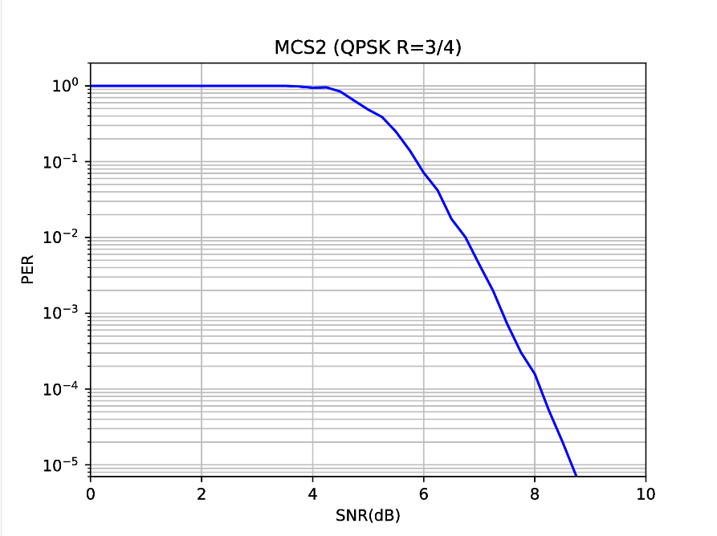
URLLC Evaluation Overview
Link simulations:
Single-stream MCS2 transmission with Binary Convolutional Coding.
Long preamble packet with single 1.728 MHz channel.
DECT-2020 NR link level simulation results indicate that the required SNR for 10⁻⁵ PER is approximately 8.6 dB.
8.6 dB is the minimum SINR level which has to be achieved in system simulations for 5th percentile of transmission to meet URLLC requirement.

Slide 19
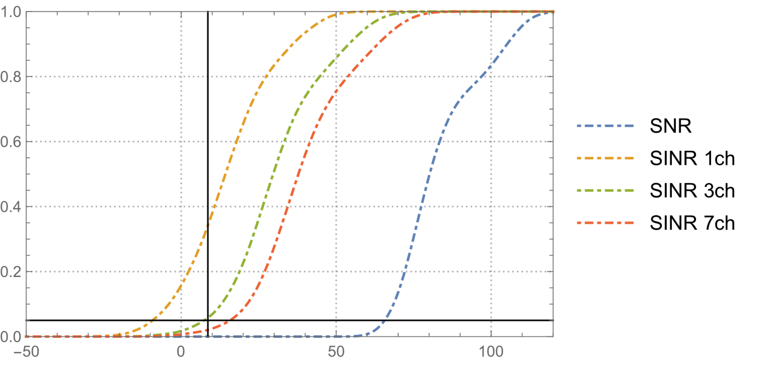
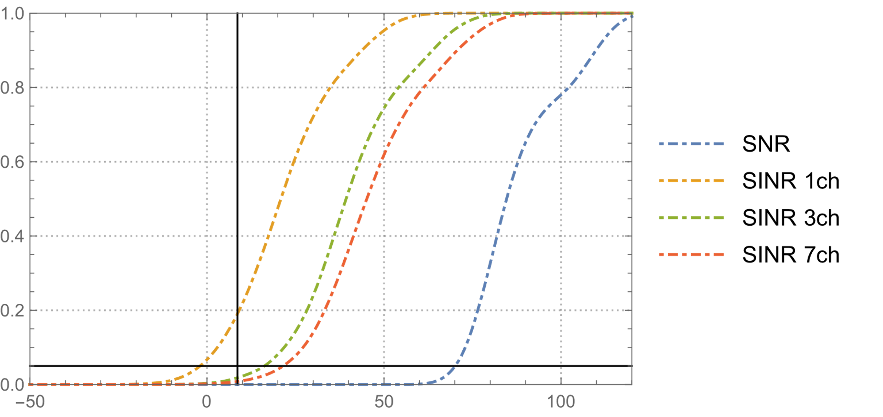
URLLC System Simulation Results
5th percentile with 8.6dB SINR crossing
5th percentile with 8.6dB SINR crossing
CDF of the SINR with Tx Power: 49 dBm, BS 5x4 Array
CDF of the SINR with Tx Power: 49 dBm, BS 15x4 Array
Number of used channels | 23dBm Tx power, 5x4 antenna arrow (dB) | 23dBm Tx power, 15x4 antenna arrow (dB) | 49dBm Tx power, 5x4 antenna arrow (dB) | 49dBm Tx power, 15x4 antenna arrow (dB)
1 | -7.7 | -1.5 | -9.0 | -1.7
3 | 7.2 | 16.1 | 7.6 | 16.6
7 | 15.5 | 22.0 | 16.2 | 21.6

Slide 20
Considerations on URLLC Simulation Results
Configurations which provides much higher SINR than minimum requirement of 8.6 dB were:
Three or more operating channels with antenna configuration having 15 x 4 antenna elements
Seven or more operating channels with antenna configuration having 5x4 antenna elements.
In addition one should note that with antenna configuration using 5x4 elements, the system SINR is less than 1.5 dB away from required SINR level with 3 channel case.
Thus the modest increase to antenna configuration would be enough.
DECT-2020 system can meet the URLLC service requirement in ITU-R Macro-URLLC evaluation environment.

Slide 21
Considerations on URLLC Simulation Results
Simulation results do not consider all possible optimizations.
Link performance can be improved significantly by using LDPC or Turbo channel coding – reducing need SINR level in system.
It is expected that typical DECT-2020 URLLC deployments will be:
Indoor factories,
Concert halls, stadiums etc. for professional audio (PMSE),
i.e. more local deployments.
These scenarios are less demanding than ITU-R URLLC system simulation environment. Therefore additional performance improvements in practical deployments may be expected
Real deployments are expected to be less inter cell interference limited compared to ITU-R evaluation scenario.
Higher data rates, reduced power or lower complexity antenna arrays may be possible

Slide 22
Summary
1) DECT-2020 is a flexible radio access technology with dynamic channel selection based on cognitive radio
Designed for private systems (coordinated or uncoordinated) with no need of frequency planning
2) DECT-2020 can meet the mMTC service requirements in ITU-R mMTC evaluation environment
connection densities of 1 000 000 devices per km² for the required data traffic
the technology also meets the requirements: using the 1 880 – 1 900 MHz frequency band (instead of 700 MHz); and with 5m antenna height (instead of 25m);
3) DECT-2020 system can meet the URLLC service requirement in ITU-R Macro-URLLC evaluation environment

Slide 23
Questions ?

